Slide 1
Data Science & analysis
An overview
Umar Khan

Slide 2
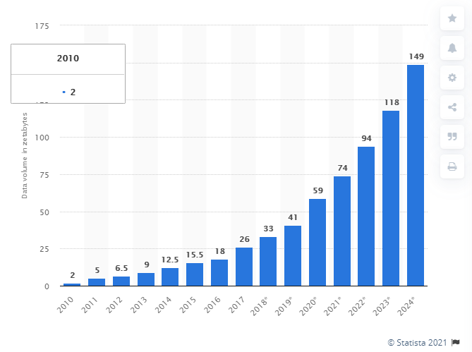
The Dramatic Growth of Data

Slide 3
Where is the Data coming from?
People
Total number of people with internet access has grown
Employees are relying more on technology to do their jobs
Things
Internet of things: More and more devices are connected and sharing their data
Sensors have become smaller, cheaper and more widely used.

Slide 4
Putting data work

Slide 5
The challenge
There is tremendous value in all this data.
The problem is unlocking it
Manually processing and analyzing that much data would be impossible.

Slide 6
Scenario
Lets say you are an agricultural facility growing crops over hundreds, maybe thousands of acres.
You decide to deploy cameras, maybe using drones, to go over your crops to try to spot weeds or infestations.
Once you have the footage, you could hire an entire team of people to review the footage to find what you are looking for.
Instead, you could hire a data scientist to train a model that could do the same thing, maybe even with better accuracy than what you would get from a team of humans, at a fraction of the cost.

Slide 7
The Data Science Process

Slide 8
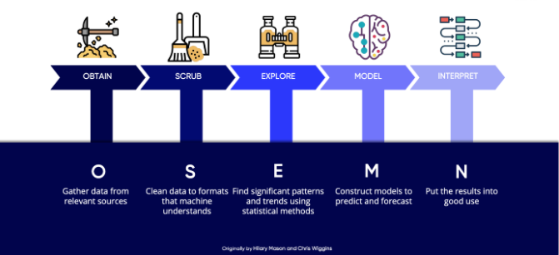

Slide 9
Obtaining
Data hardly ever exists in an easily accessible, unified location.
It can be spread out over numerous sources, in many different formats
SQL Databases
NoSQL Databases
Spreadsheets
E-mails
Word documents
Folders full of images/videos
Sensor data
Proprietary formats

Slide 10
Scrubbing
Data is almost always messy
This usually has to do with how it’s generated or captured
Human error
Variations in generation process (over time or across domains)
Duplication, redundancy, overlap
Varying formats/types
Missing Data
Notes:
Human error: incorrectly entered data, errant key strokes, misspellings
Variaiton on process: systems can measure values on different scales
Varying formats: dates stored as strings or numbers

Slide 11
Exploration
Exploring your data to find patterns and trends
Calculate statistics:
Central tendency: Mean, Median
Spread: Variance, Standard Deviation
Distribution of Categorical variables
Charts!
Co-variance and co-relation with other variables
Hypothesis testing
Feature engineering

Slide 12
Modeling
The heart of modern AI and Data Science – Feeding data into algorithms
Large variety of algorithms available, each suitable for different situaions
Two main categories:
Supervised Learning Models
Unsupervised learning models
Very finnicky: Input data needs to be processed just right
A Data Scientist’s job is to fit and evaluate the models and make improvements in an iterative way.

Slide 13
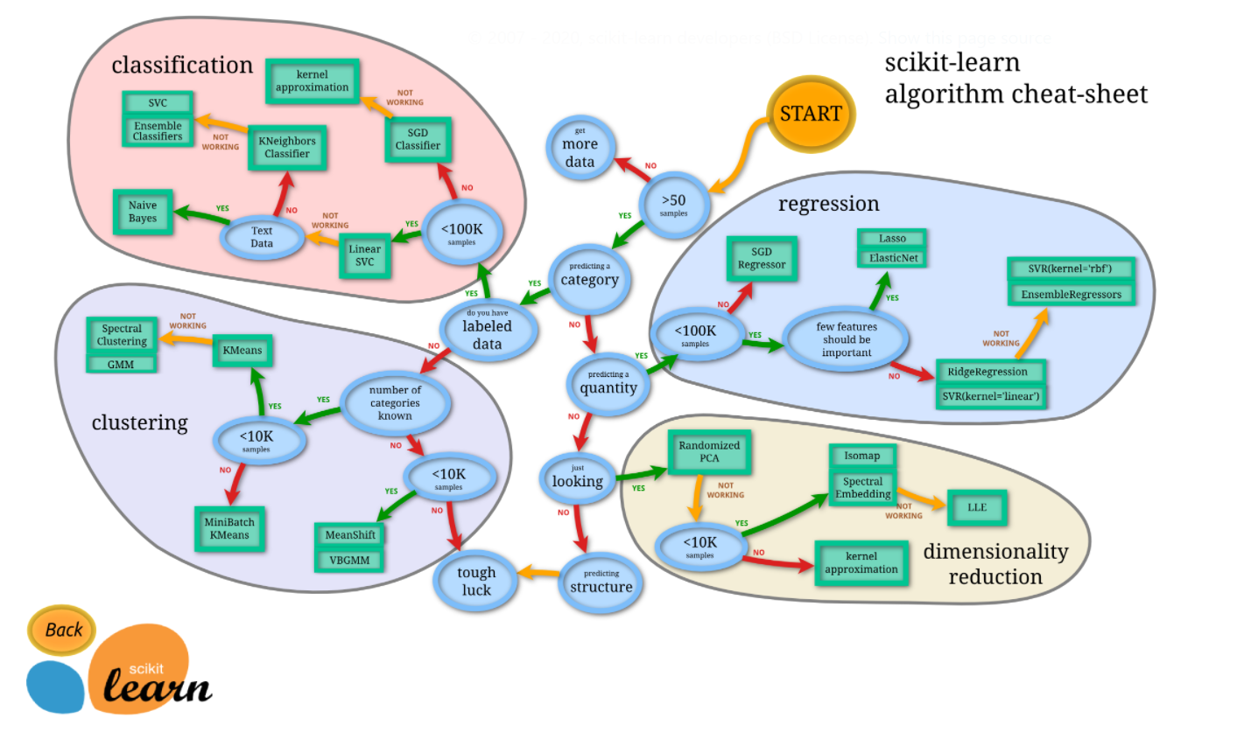

Slide 14
Unsupervised Models
Supervised Learning Models
“Predictive” models.
Learn the relationship among input variables and the “target variable”
Can then predict the value of the target variable for new set of observations of input variables.
Two main types;
Regression: Target variable is “continuous”
Classification: Target is “categorical”
Used mainly to find patterns in the data and/or try to organize it
Does not require labeled data.
Two main types:
Cluster analysis
Principale Component analysis

Slide 15
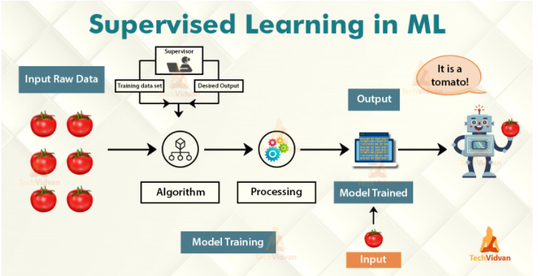

Slide 16
Model Performance

